Slide 1
TWO WHEELER SERVICE CENTER Developed by: Nishad Kanago : 112003063 SY Comp Div 1 Batch S4 Guided by : Khushal Khairnar sir
Problem statement :
The project is about two wheeler service center.
It contains the details of the customer and the type of service selected

Slide 2
The tools used are:
Tkinter : For developing GUI
SMTPLIB : For sending mails
Pandas : For generating csv, xlsx files
Win32com : For generating pdf files
For storing the customers details mysql database is used.
Mysql.connector : To connect python and mysql

Slide 3
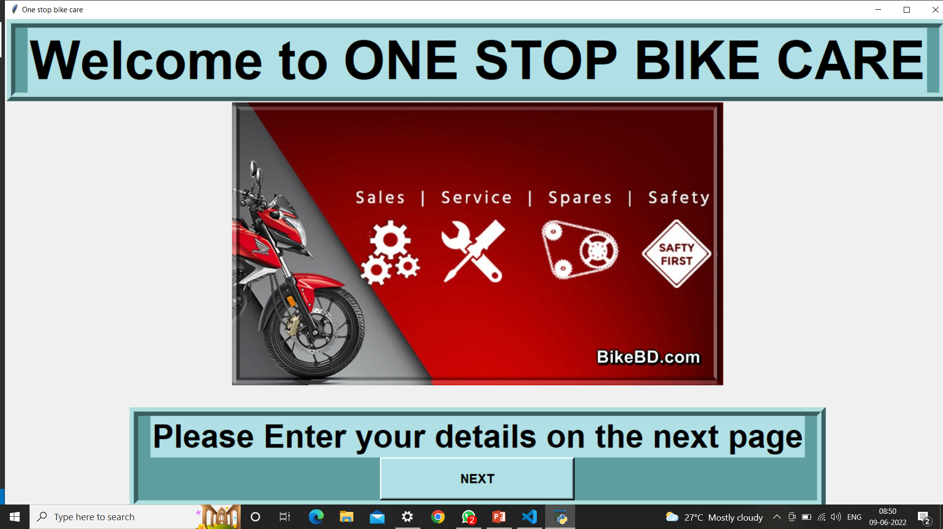

Slide 4
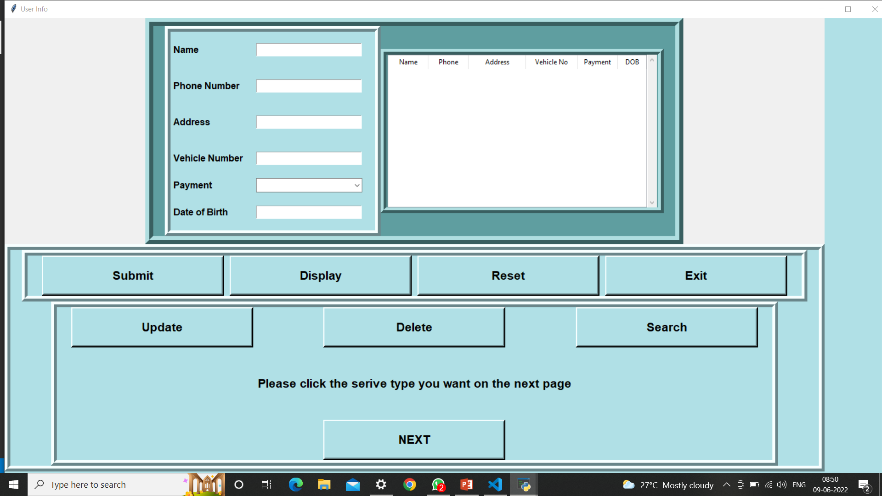

Slide 5
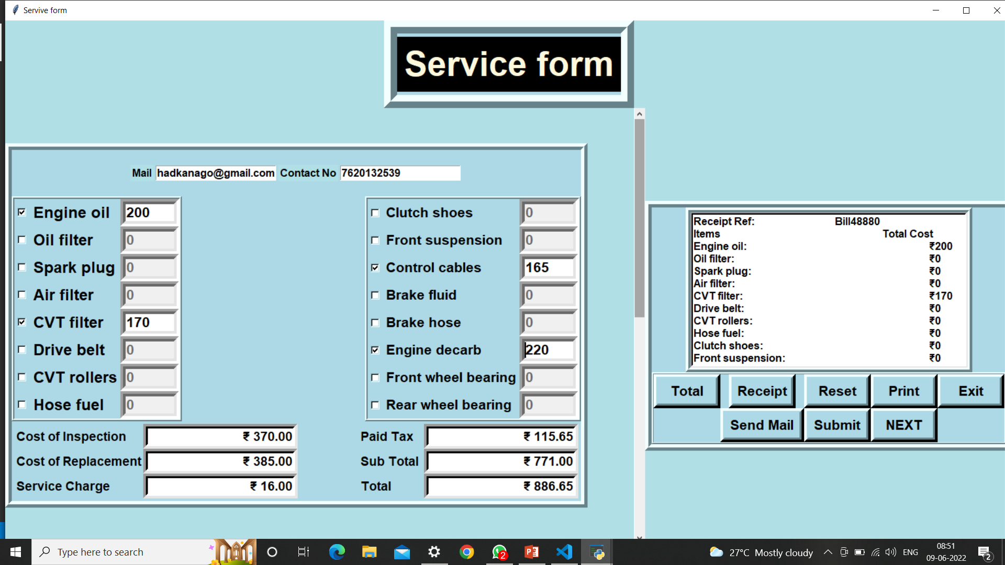

Slide 6
First slide is WELCOME slide
Second slide is all about the customer details whose records gets stored in Mysql database
The third slide contains the service form.
The cost of a particular service gets displayed next to its label when clicked on it.
The total button calculates the total cost along with tax.
Receipt button generates a receipt in the right text box
Print button generates info.txt files containing the information and total cost of selected services.
The submit button generates a customer.pdf file
The Send mail button sends a mail to the user attached with txt files describing the
Selected services and their respective cost.
Thank You !!

